Slide 1

Goal Connect
Problem Statement
Football Performance and Engagement Portal

Slide 2


Slide 3
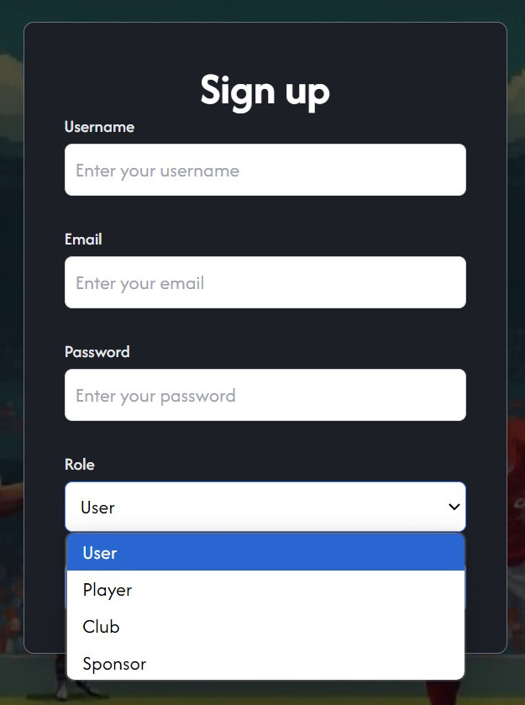
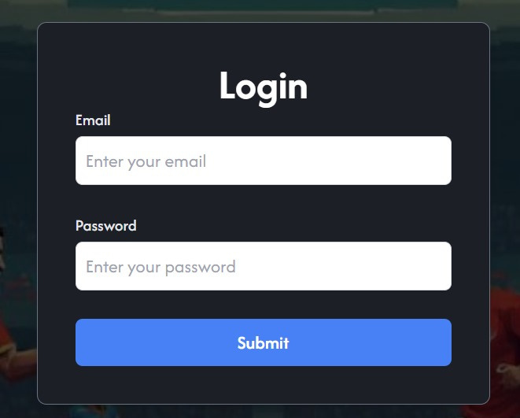
While signing up in our website we can sign up as a player, a club, a user/fan, or a sponsor
On signing up we can login with same email and password we will be redirected to the respective dashboards according to the client

Slide 4

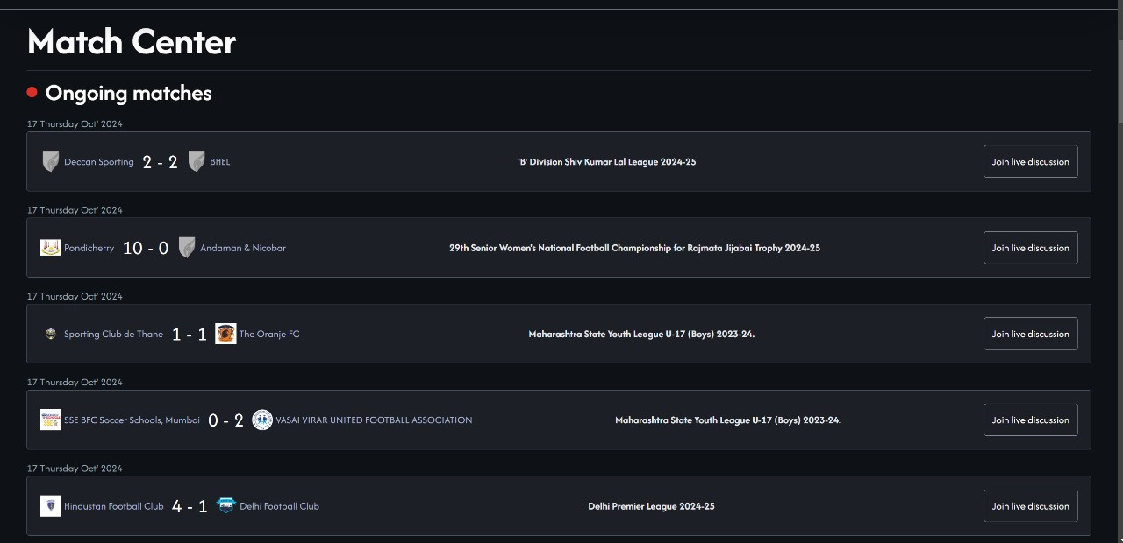
First lets look into what the user as a fan will see
This is match hub where user can see all the ongoing matches upcoming matches and past matches

Slide 5
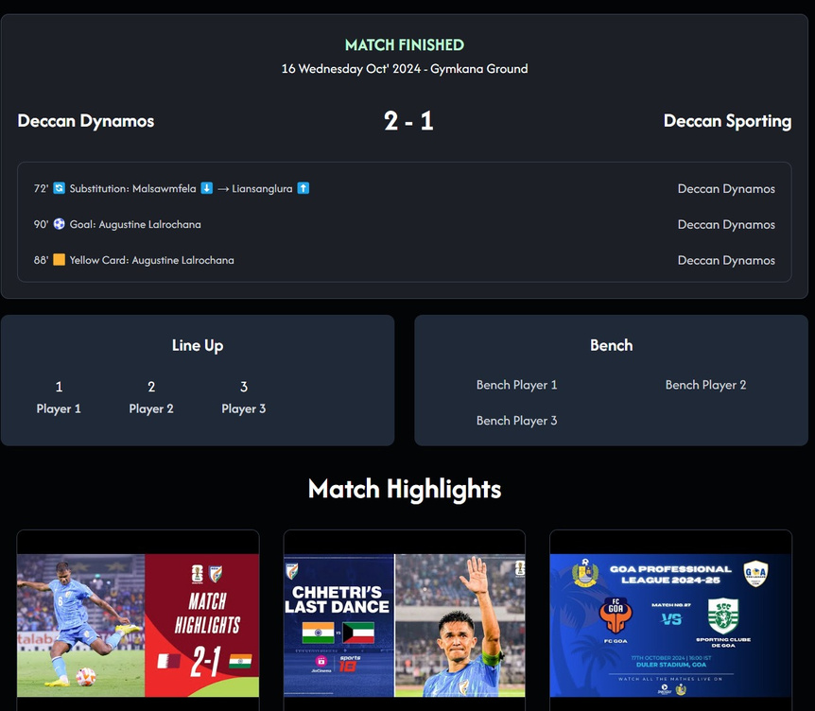
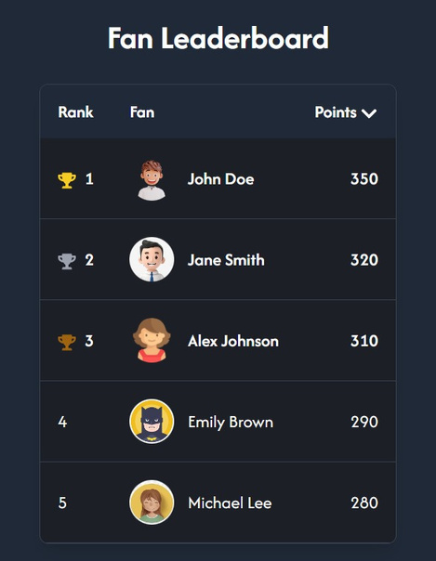
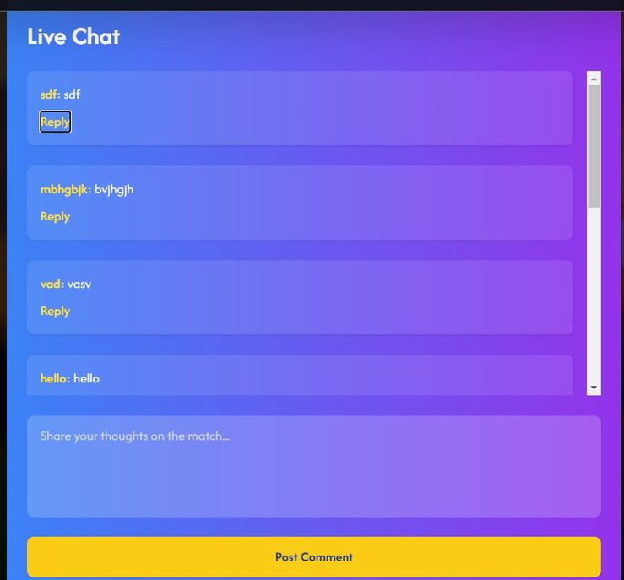
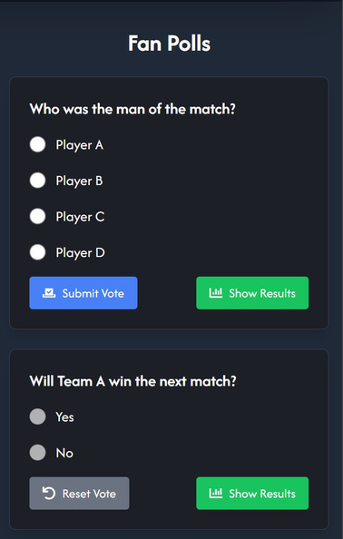
with statistics and fan interative elements like live chat for ongoing matches and and highlights for past matches along with

Slide 6
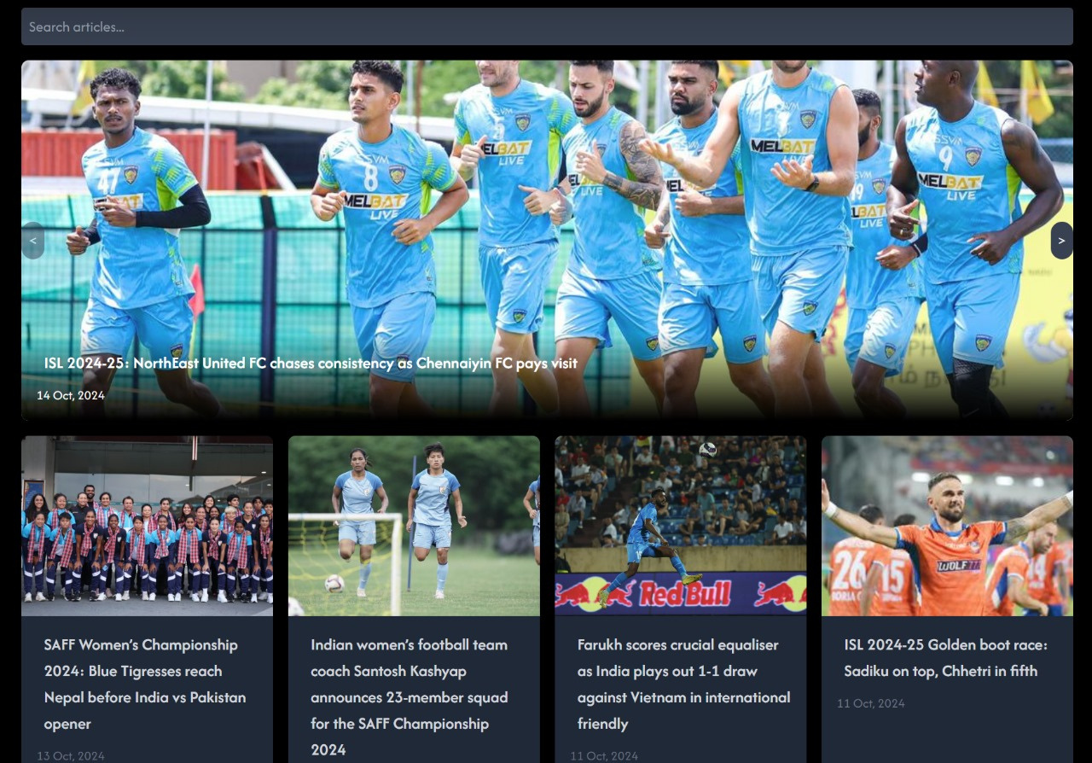
News and updates

Slide 7
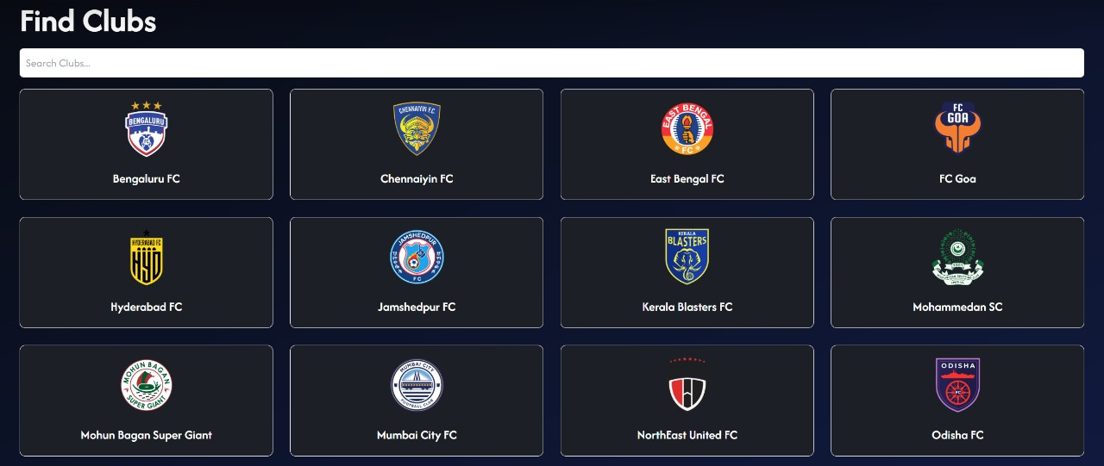
Clubs

Slide 8
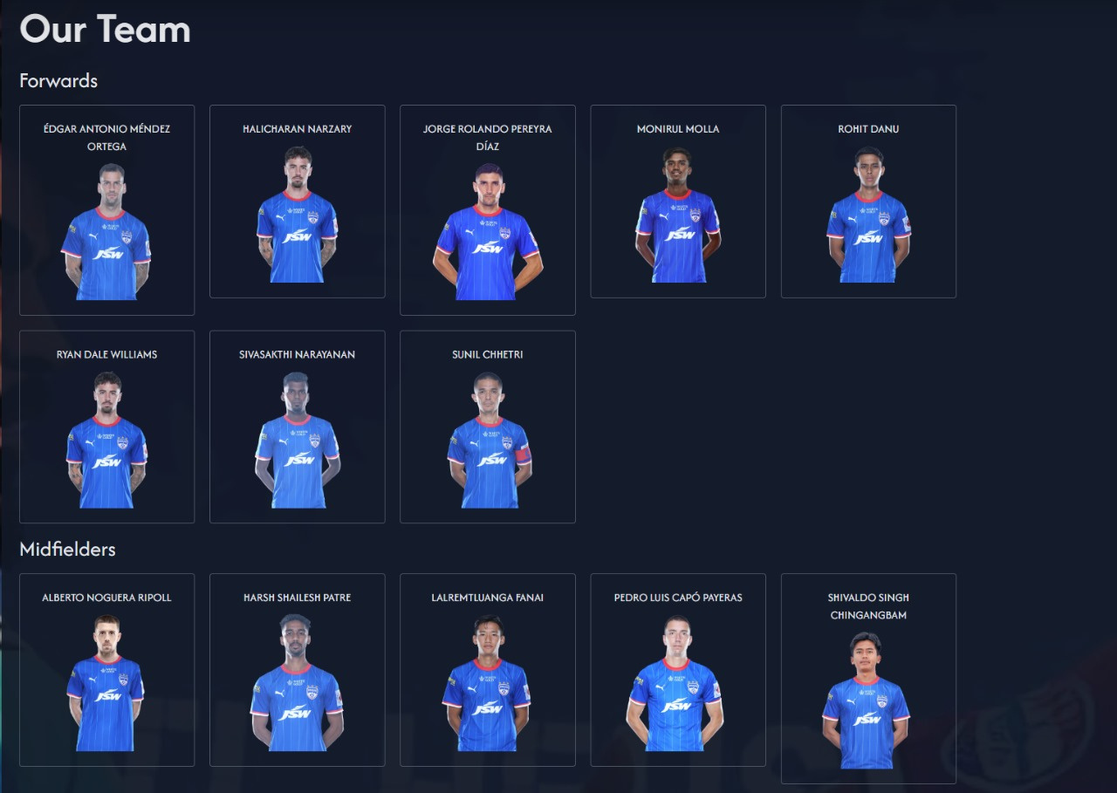
Club profiles with all its players - forwards, midfields, goalkeepers defenders and coach will be displayed

Slide 9
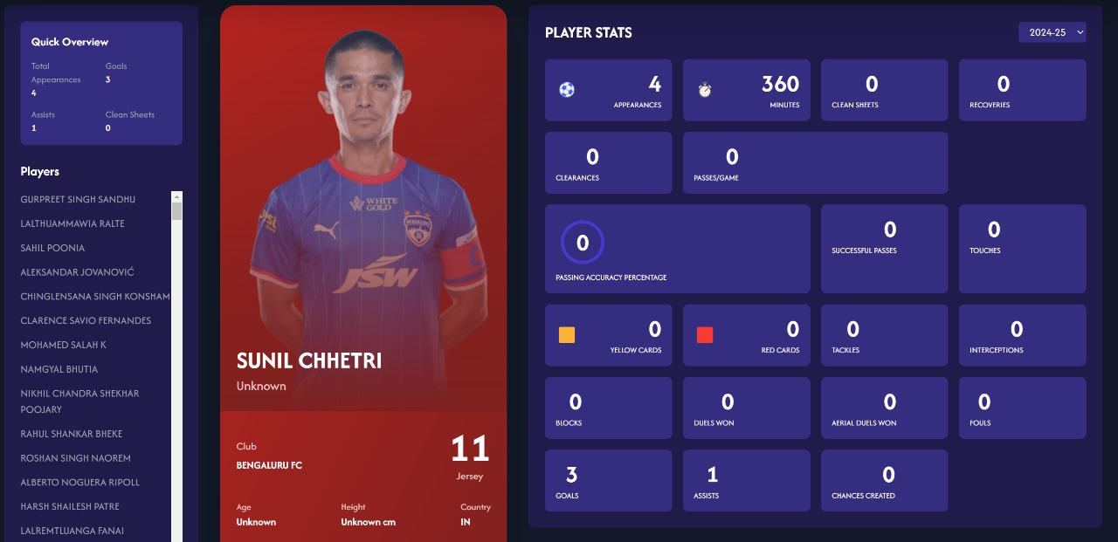
With detailed statistics of each and every player

Slide 10
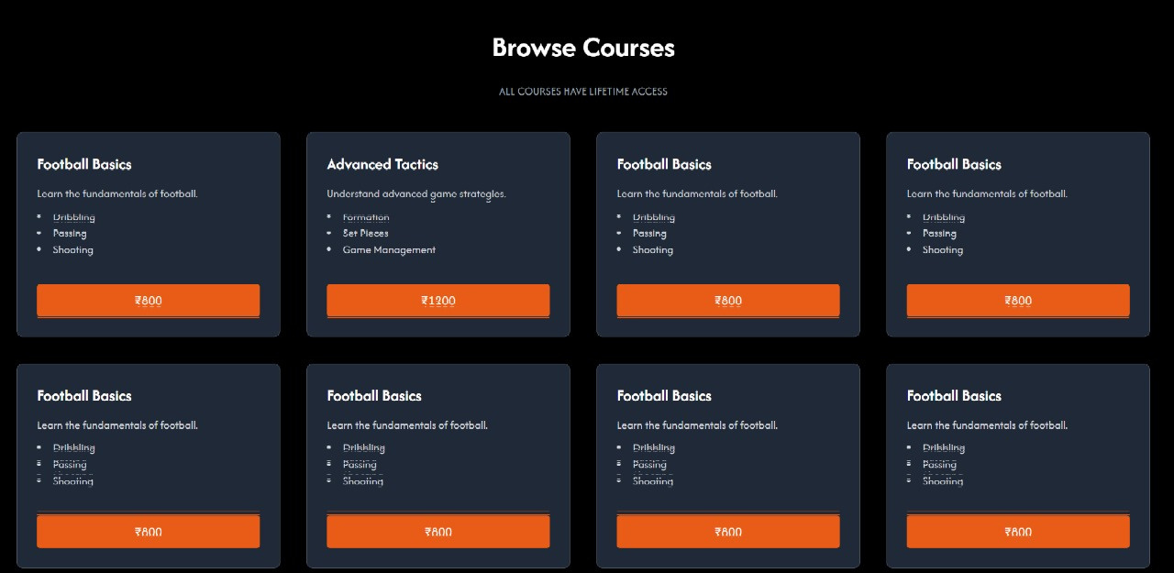
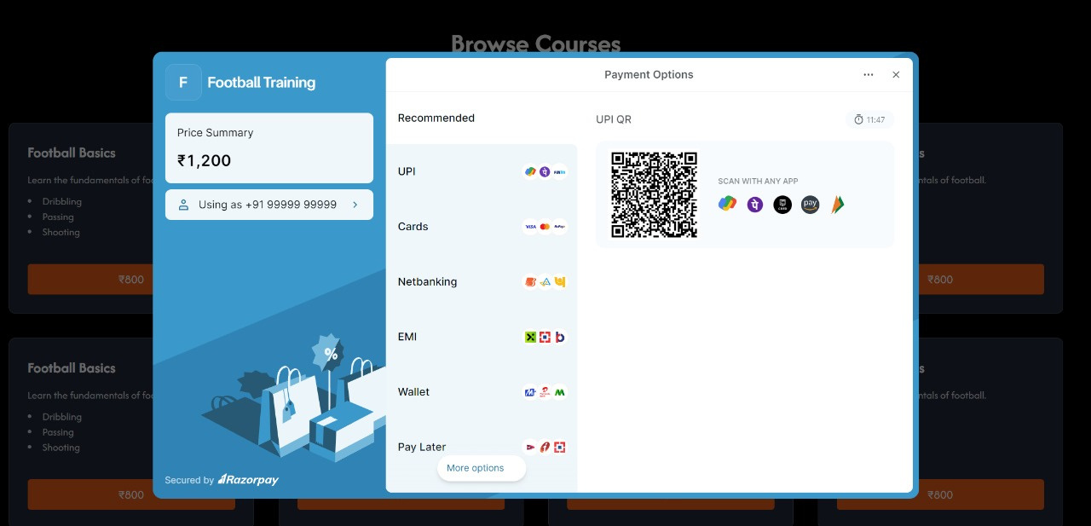
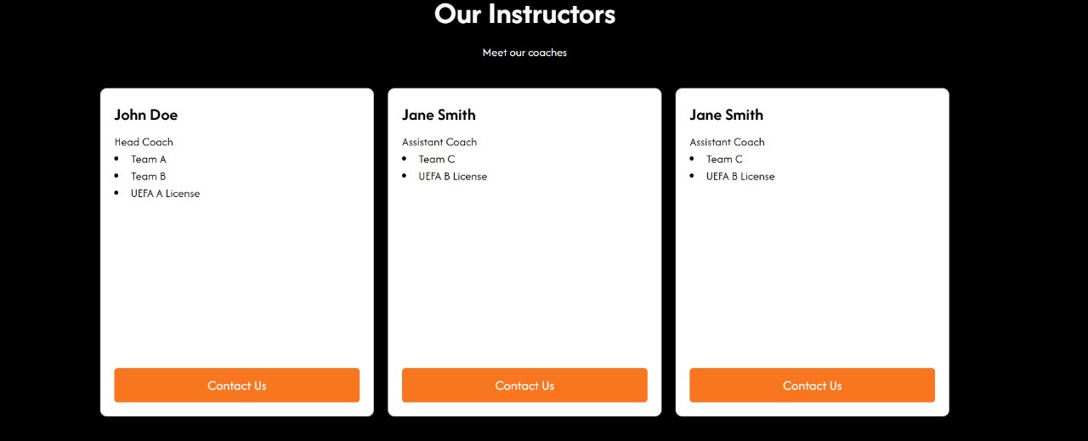
Digital football academy

Slide 11
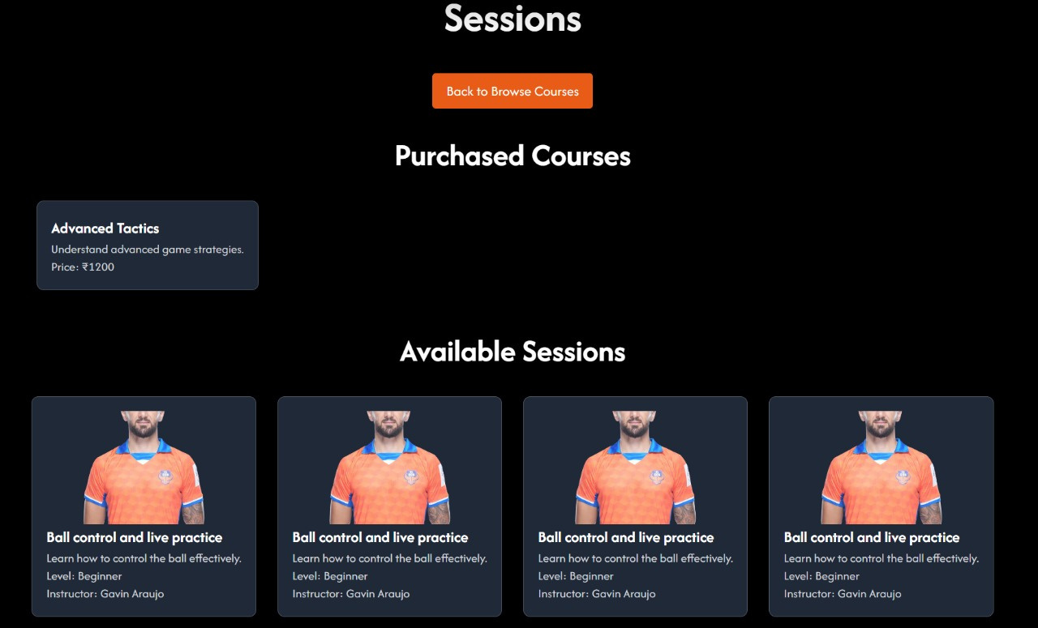
on making a successfull payment it shows all the sessions

Slide 12
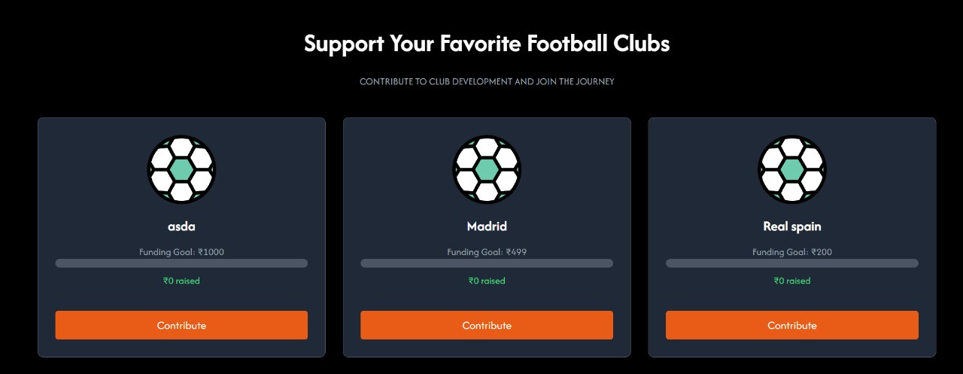
CrowdFunding

Slide 13
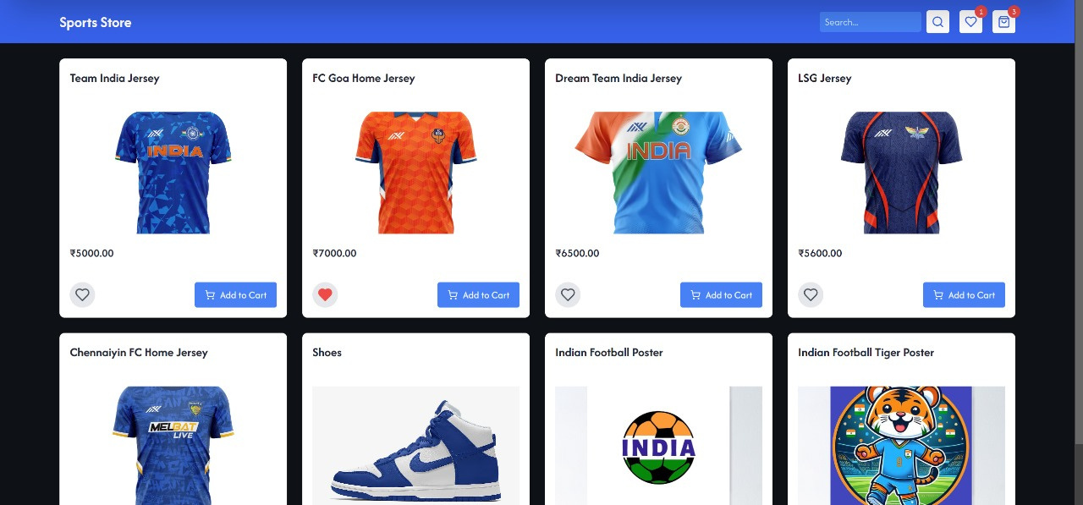
E-commerse element with razor pay

Slide 14
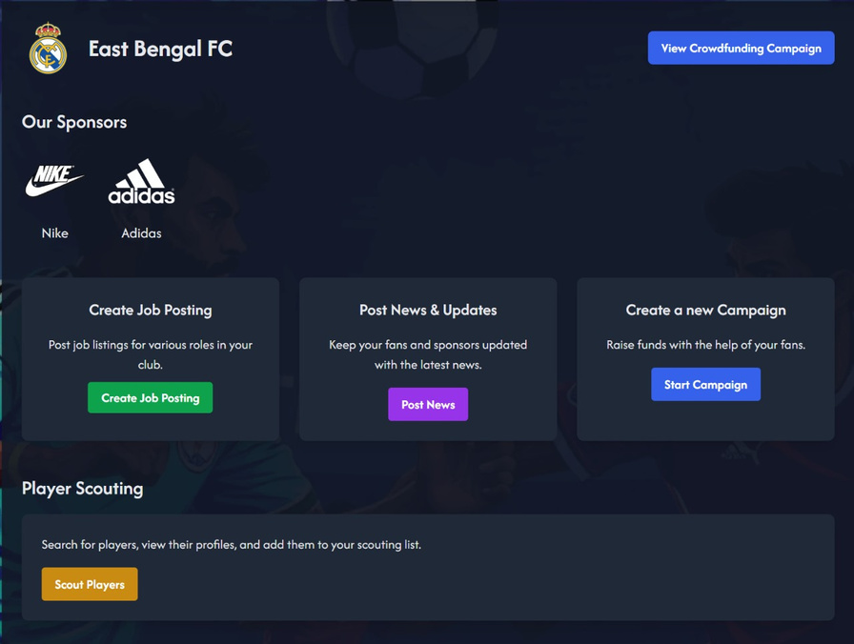
Now lets look at all the feautures which will be vissible as a club
Club dashboard with its details
along with features like create job posting post news start campaign and scout players

Slide 15
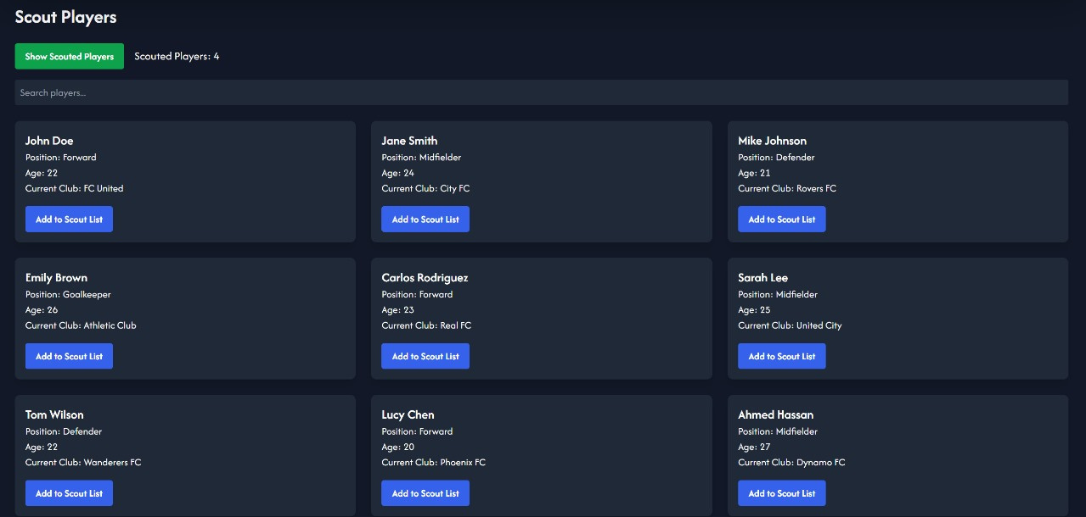
scouting players

Slide 16
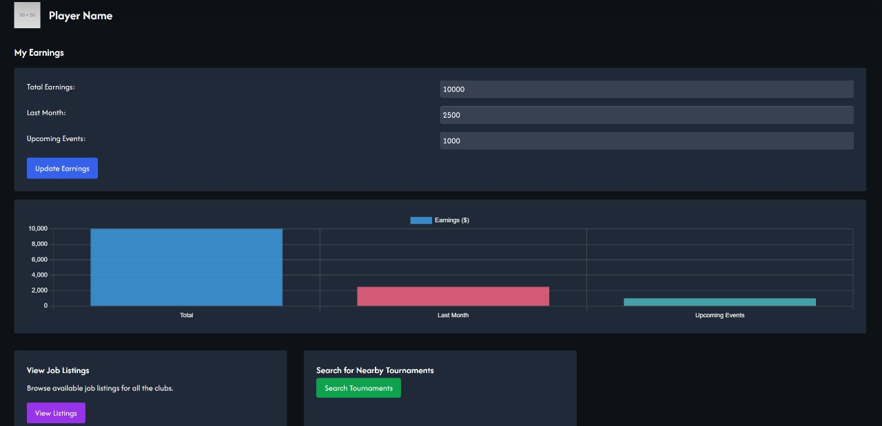
Player dashboard

Slide 17
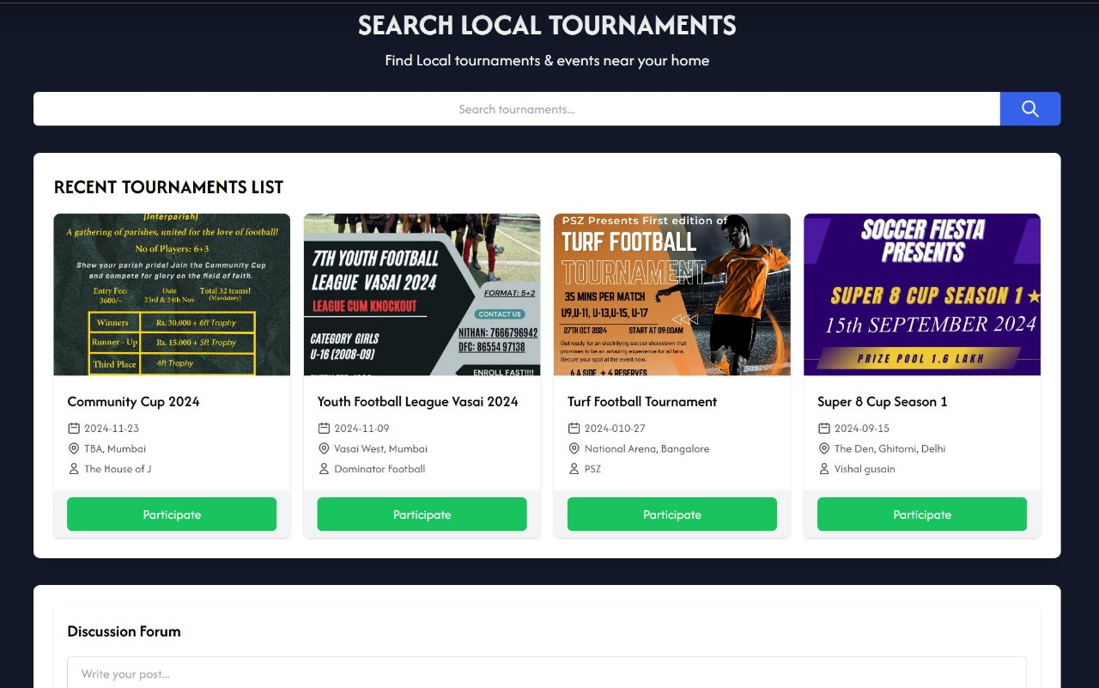
Search for local tournaments

Slide 18
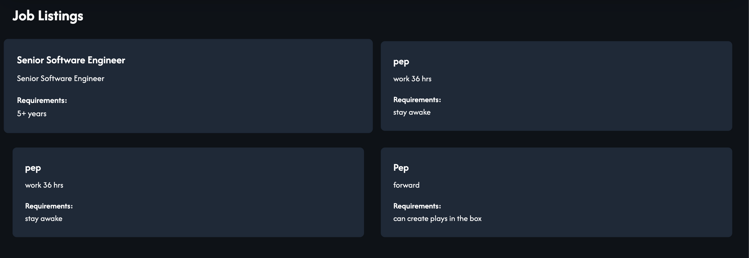
Viewing job listings

Slide 19
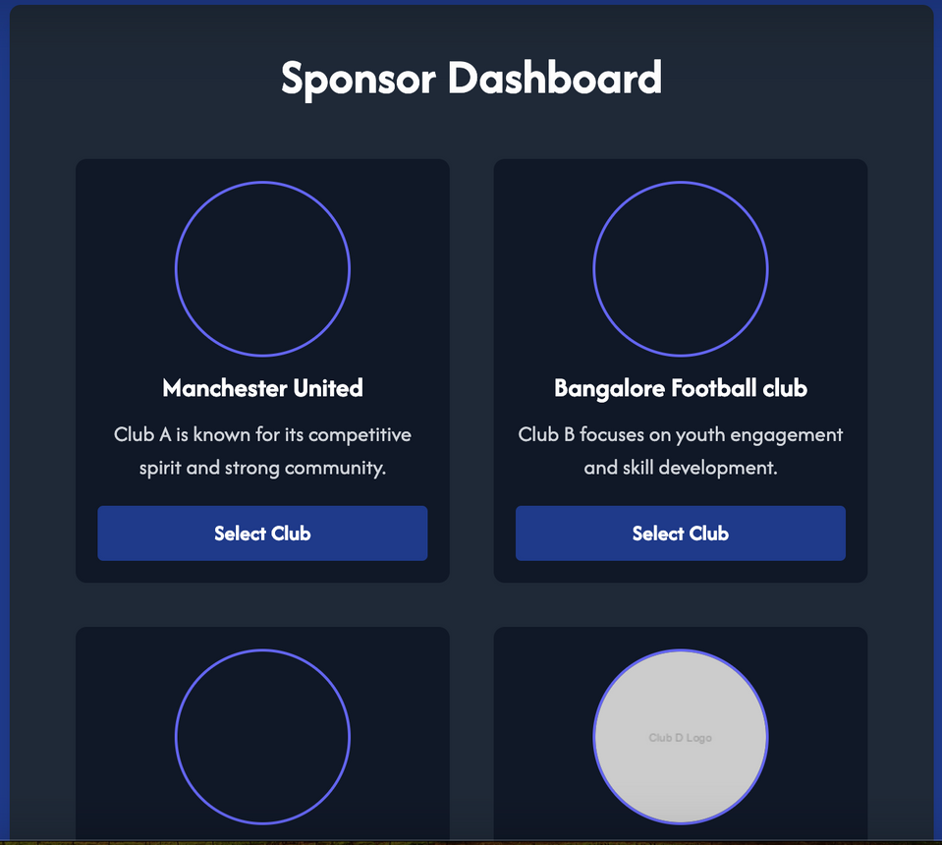
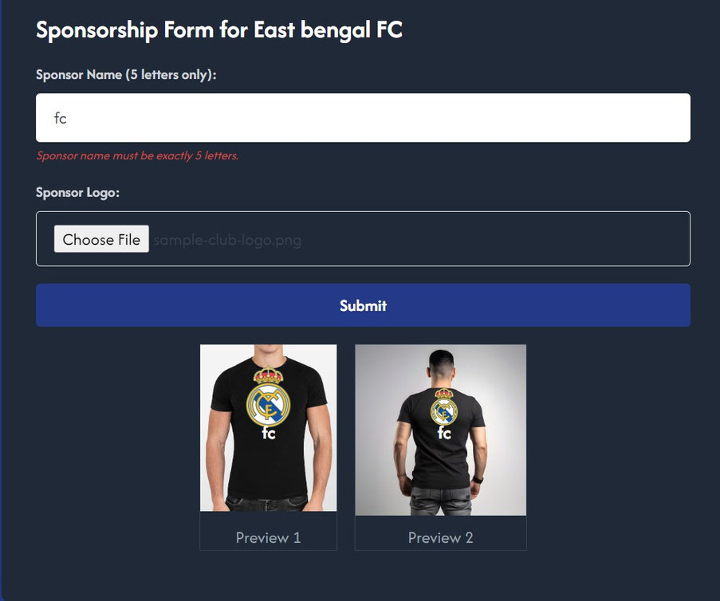
This is the dashboard for the sponsor

Slide 20
Thank you

